Slide 1
SCHOOL NUTRITION Overview
Ayshia Ranjitsingh, RDN, LD, CD – Dietitian Amber Easter, GM – Woodland School District
Notes:
General overview of SBP/NSLP regulations
Meal component requirements, including what we are required to limit
Explanation of offer vs. serve
Discussion of sharing tables and offering bars
Summary of major items from survey feedback with responses (discussed throughout presentation)

Slide 2
Agenda
Terms
School Meal Regulations
What are the SBP and NSLP?
Meal Pattern Requirements – Basics
Meal Pattern Requirements - Components
Examples of Reimbursable Meals
Additional Resources
Offer vs. Serve
Notes:
Update slide**

Slide 3
Terms
OSPI: Office of Superintendent of Public Instruction
CNS: Child Nutrition Services
CNP: Child Nutrition Program
USDA: United States Department of Agriculture
Oz Eq: Ounce Equivalents

Slide 4
School Meal Regulations
School meal regulations affect what goes into the meals students receive every day for breakfast and lunch.
Without following federal and state nutrition standards for school meals, school meal programs would not be able to receive federal reimbursement for any meals they serve.

Slide 5
School Meal Regulations
Richard B. Russell National School Lunch Act of 1946: Established NSLP
Child Nutrition Act of 1966: Established the pilot version of the SBP and other child nutrition programs
These programs are reviewed and amended by Congress every 5 years through Child Nutrition Reauthorization

Slide 6
School Meal Regulations
Healthy, Hunger-Free Kids Act (HHFKA) of 2010
Goal: To help ensure every American child has access to the nutrition needed to grow into healthy adults
Results:
Created the Community Eligibility Provision (CEP), allowing high-poverty school districts to offer breakfast and lunch at no charge
Increased the # of low-income children automatically certified for free school meals (direct certification)
Improved and updated nutrition standards for school meals by increasing the amount of fruits and vegetables served, emphasizing whole grain-rich foods, requiring low- or non-fat milk, and providing dietary specifications for sodium, calories, and saturated fat

Slide 7
School Meal Regulations
Final Rule of Spring 2024
USDA issued a “final rule” on long-term school nutrition standards in 2024
Updates standards set forth in the HHFKA of 2010
Includes added/total sugar limits & sodium reductions to be phased in beginning as early as 2025
Establishes long-term milk and whole grain requirements

Slide 8
What are the SBP and NSLP?
School Breakfast Program (SBP) and National School Lunch Program (NSLP)
Funded by the USDA
Administered by the OSPI
Provides reimbursement for meals served that meet federal requirements
Must meet the current meal pattern and nutrition standards set by the USDA

Slide 9
Meal Pattern Requirements - Basics
All meals must be nutritious, well-balanced, and age-appropriate
Meals must meet food component and quantity requirements for SBP and NSLP based on age/grade group
Age/grade groups are:
K-5
6-8
9-12
Weekly requirements are based on a 5-day school week
Must meet dietary specifications for calories, saturated fat, and sodium
Must produce enough food to provide all students with a reimbursable meal

Slide 10
Dietary Specifications
Calories: Calorie ranges are to be met on average over the school week
Intent is to avoid excessive calories
Meal pattern provides more nutrient-dense meals by including more fruits, vegetables, and whole grains
 | Grade K-5 | Grade 6-8 | Grade 9-12
Breakfast | 350-500 kcal | 400-550 kcal | 450-600 kcal
Lunch | 550-650 kcal | 600-700 kcal | 750-850 kcal

Slide 11
Dietary Specifications
Sodium: Sodium is restricted as a weekly average with further restrictions required in 2027
Includes all menu items and condiments
Saturated Fat: Saturated fat is a weekly average and should be less than 10% of total calories
 | Grade K-5 | Grade 6-8 | Grade 9-12
Breakfast | < or = 540 mg | < or = 600 mg | < or = 640 mg
Lunch | < or = 1110 mg | < or = 1225 mg | < or = 1280 mg

Slide 12
Meal Pattern Requirements - Basics
Food Items | Food Components | Combination Foods*
A specific food offered within a food component THINK: One Banana, One Carton of Milk | One of the 5 food groups which comprise reimbursable meals THINK: Milk, Meat/Meat Alternates, Grains, Vegetables, Fruits | Provide a combination of multiple food components Hamburger (Grains + Meat/MA) Cheese Pizza (Grains + Meat/MA + Vegetables)

Slide 13
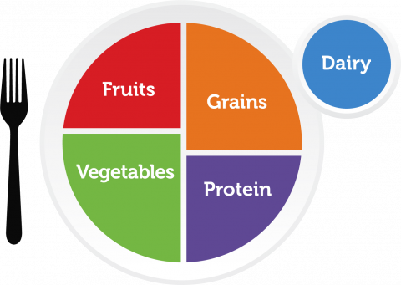
Meal Pattern Requirements - Components
Meat/Meat Alternates (M/MA)
Grains
Fruit
Vegetables
Five vegetable subgroups
Milk

Slide 14
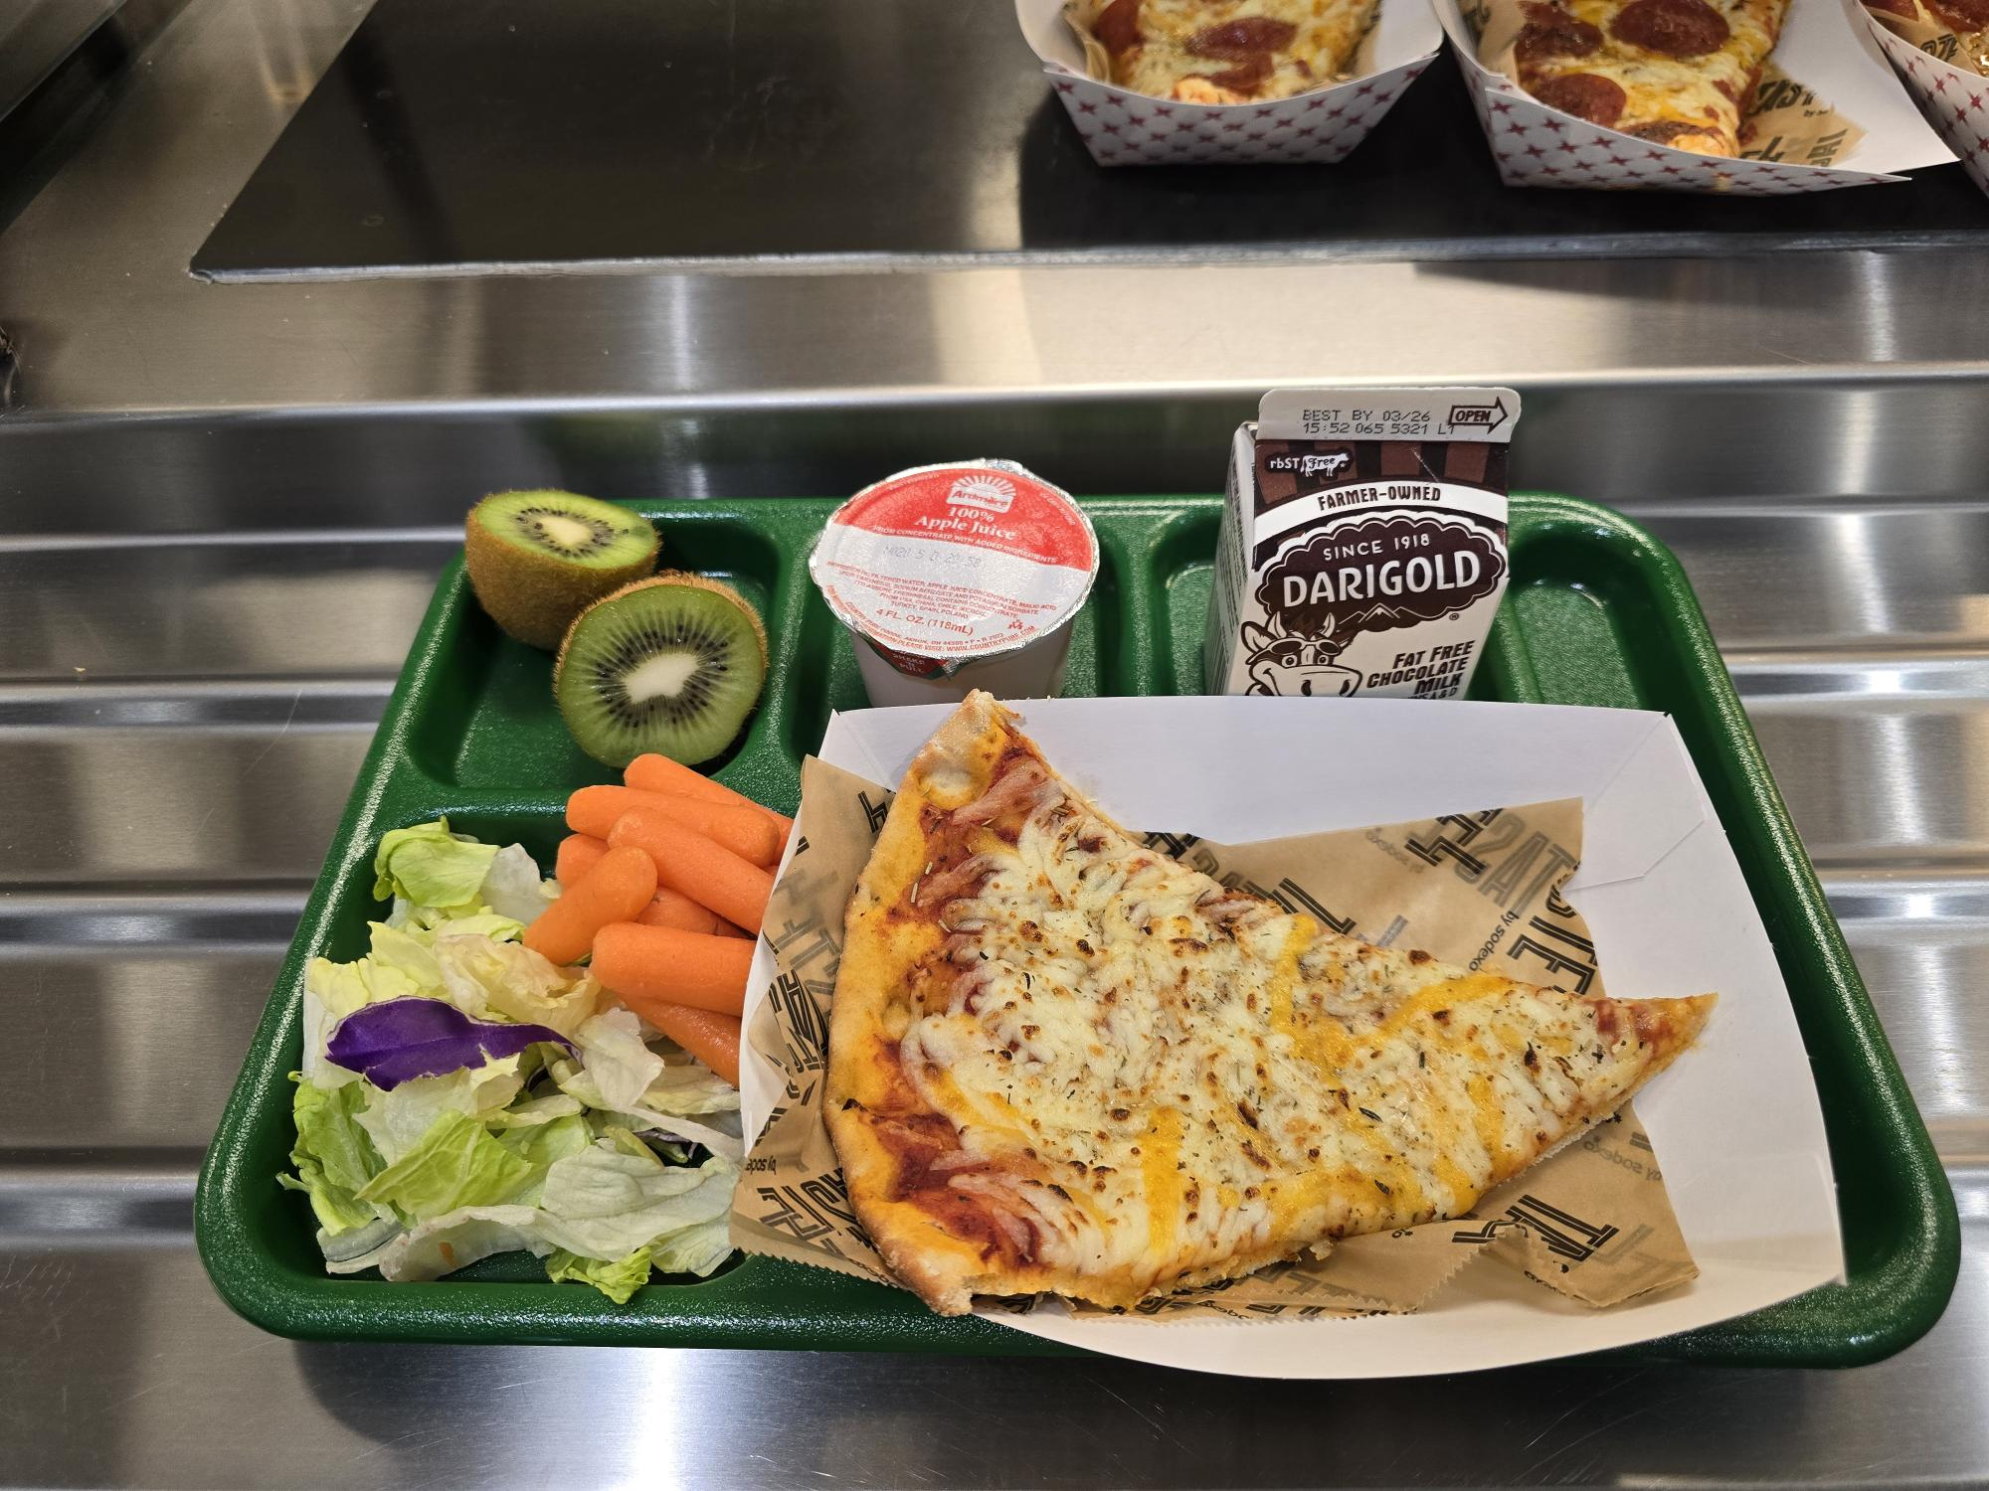
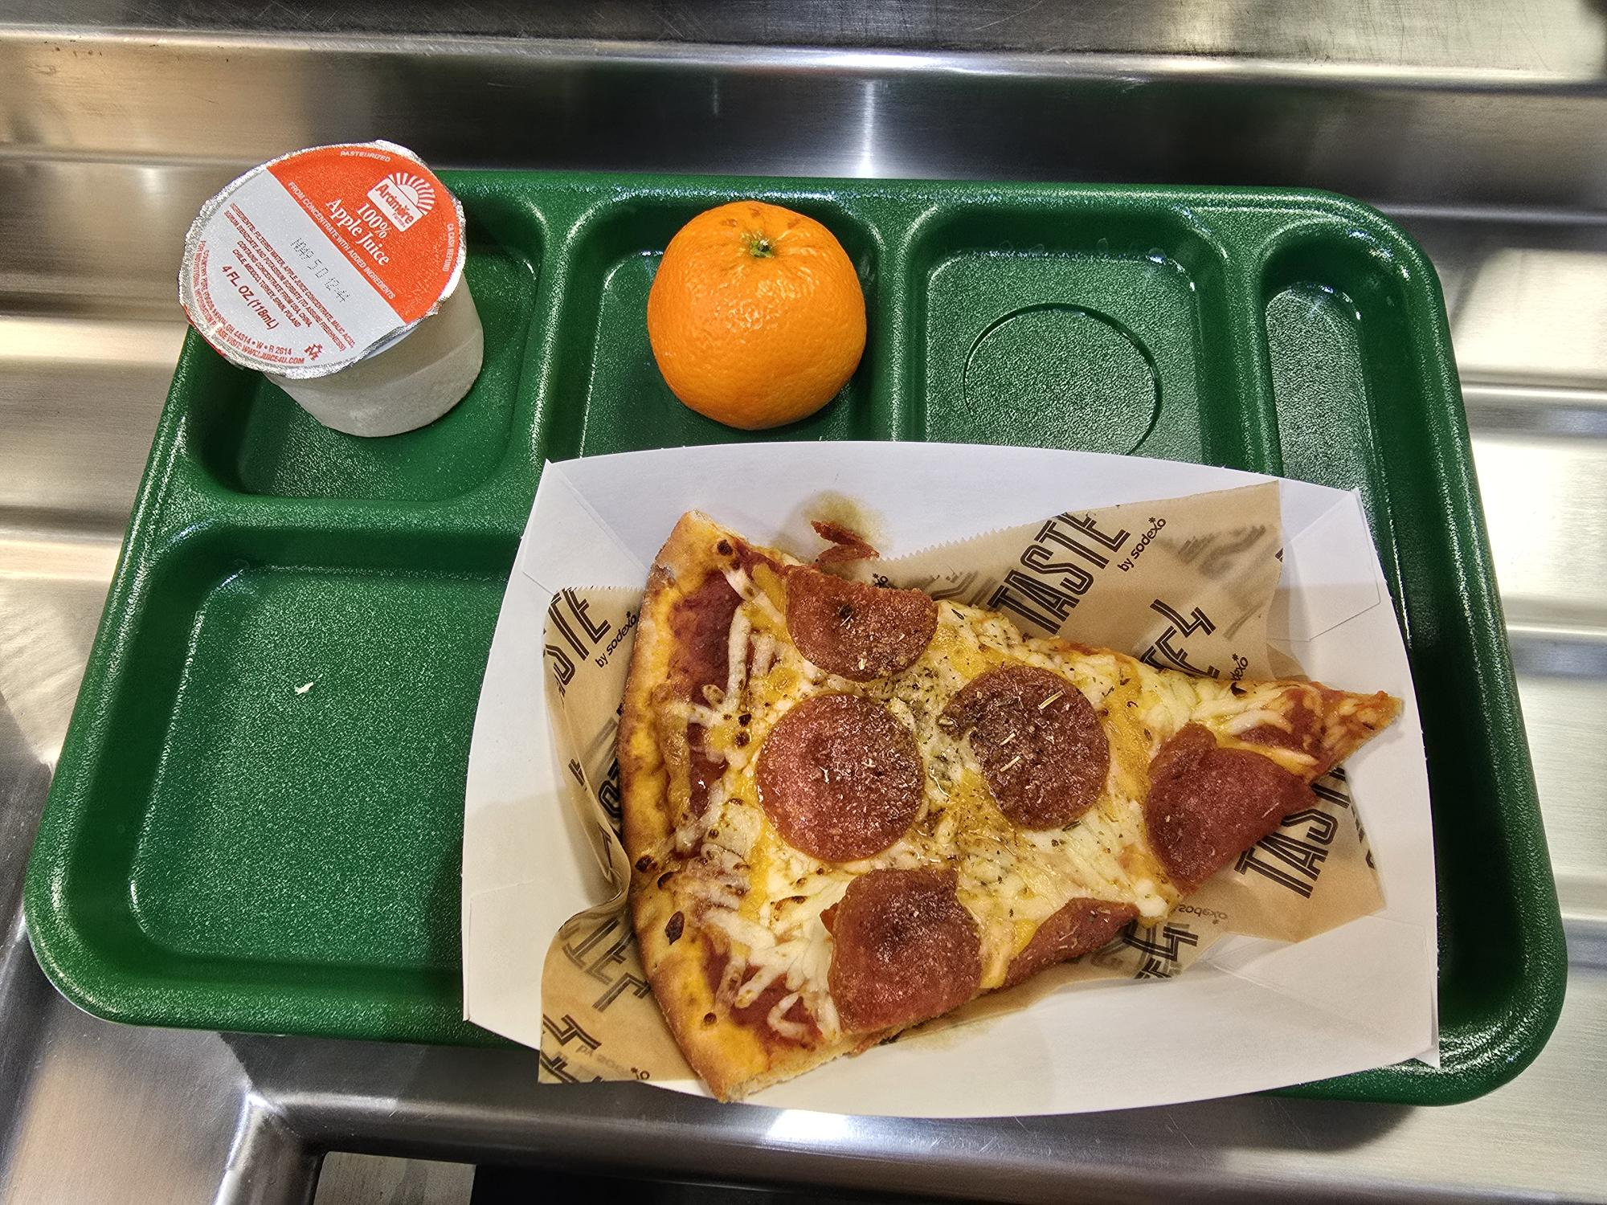
Meal Pattern Requirements - Components
Meat/Meat Alternates (M/MA)
Based on minimum daily servings PLUS total servings over a 5-day school week
Quantity must be the edible portion as served
Final Rule establishes Grains and M/MA as a combined category at breakfast only*
Schools may offer Grains, M/MA, or a combination of both to meet minimum oz eq
Available to Student
Student Choice

Slide 15
Meal Pattern Requirements - Components
Meat/Meat Alternates (M/MA)
 | Grade K-5 | Grade 6-8 | Grade 9-12
Breakfast (Grains and/or M/MA)* | 7 oz eq/week (1 oz eq daily min) | 8 oz eq/week (1 oz daily min) | 9 oz eq/week (1 oz daily min)
Lunch (M/MA only)* | 8-10 oz eq/week (1 oz daily min) | 9-10 oz eq/week (1 oz daily min) | 10-12 oz eq/week (2 oz daily min)
Available to Student
Student Choice

Slide 16
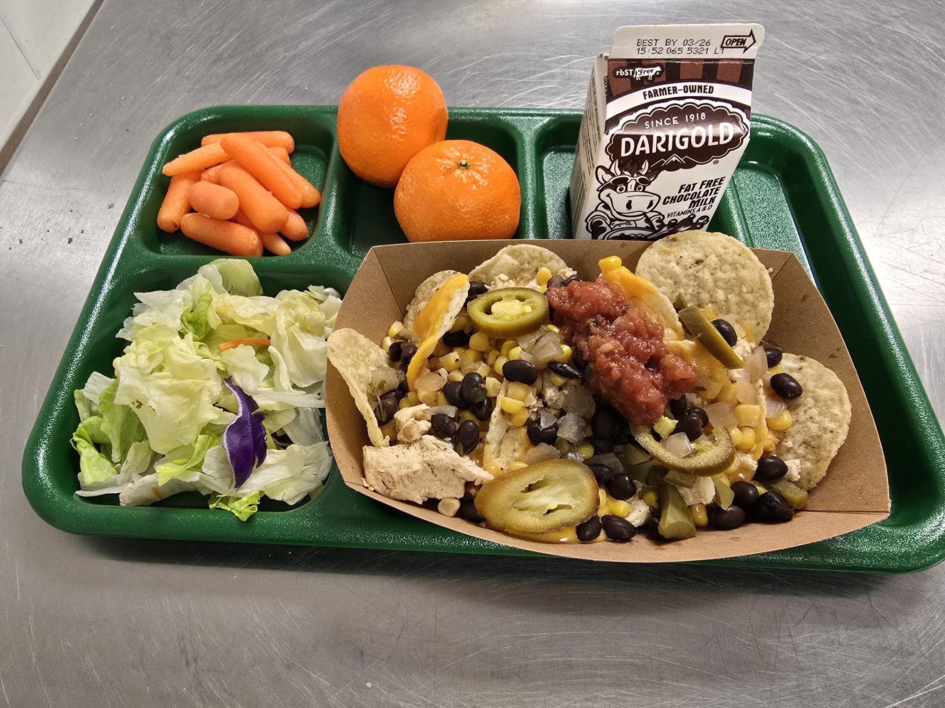
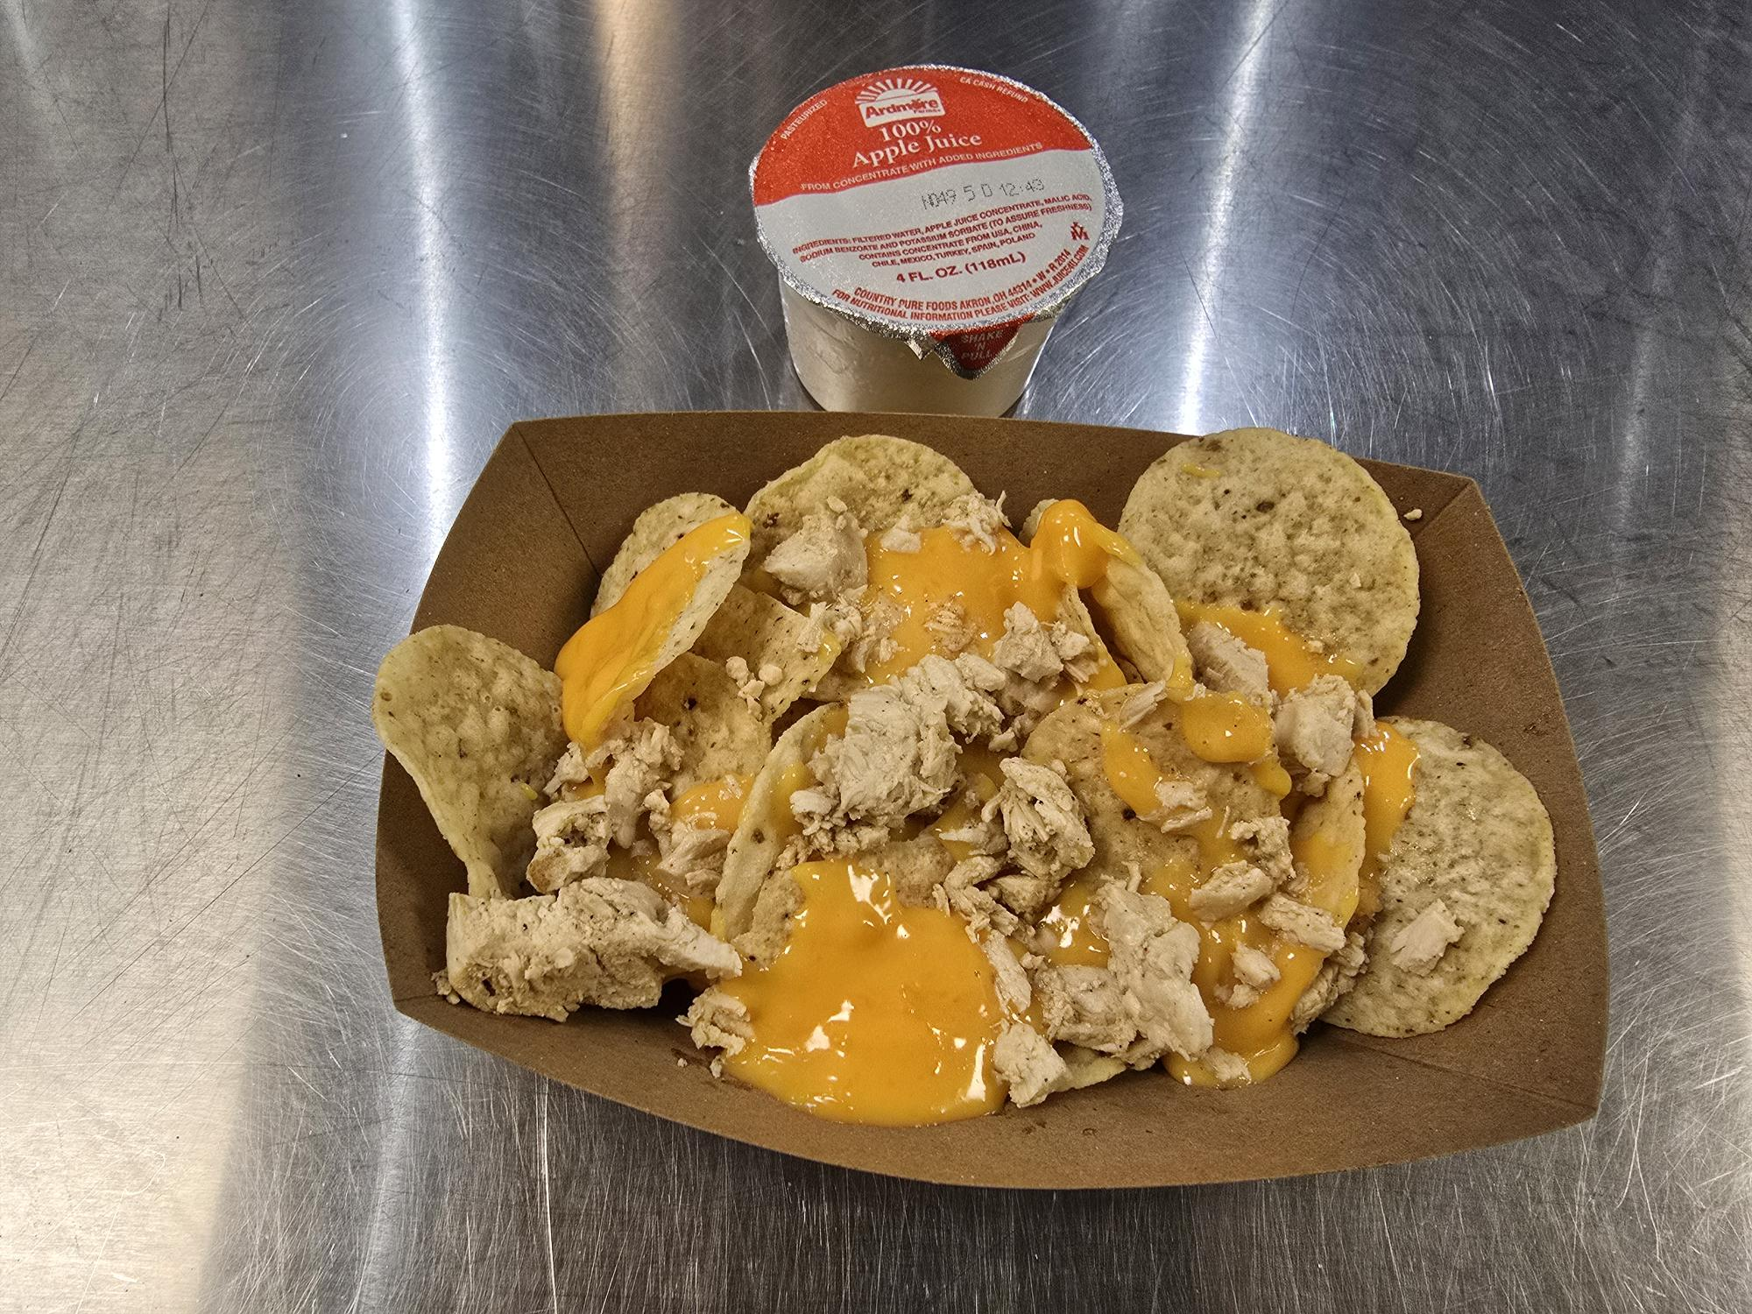
Meal Pattern Requirements - Components
Grains (G)
At least 80% of weekly grains offered must be whole grain-rich
Whole Grain-Rich: > or = 50% whole grain with remaining grains in product being enriched
Based on minimum daily servings PLUS total servings over a 5-day school week
Available to Student
Student Choice

Slide 17
Meal Pattern Requirements - Components
Grains (G)
 | Grade K-5 | Grade 6-8 | Grade 9-12
Breakfast (Grains and/or M/MA)* | 7 oz eq/week (1 oz eq daily min) | 8 oz eq/week (1 oz daily min) | 9 oz eq/week (1 oz daily min)
Lunch (Grains only)* | 8-9 oz eq/week (1 oz daily min) | 8-10 oz eq/week (1 oz daily min) | 10-12 oz eq/week (2 oz daily min)
Available to Student
Student Choice

Slide 18
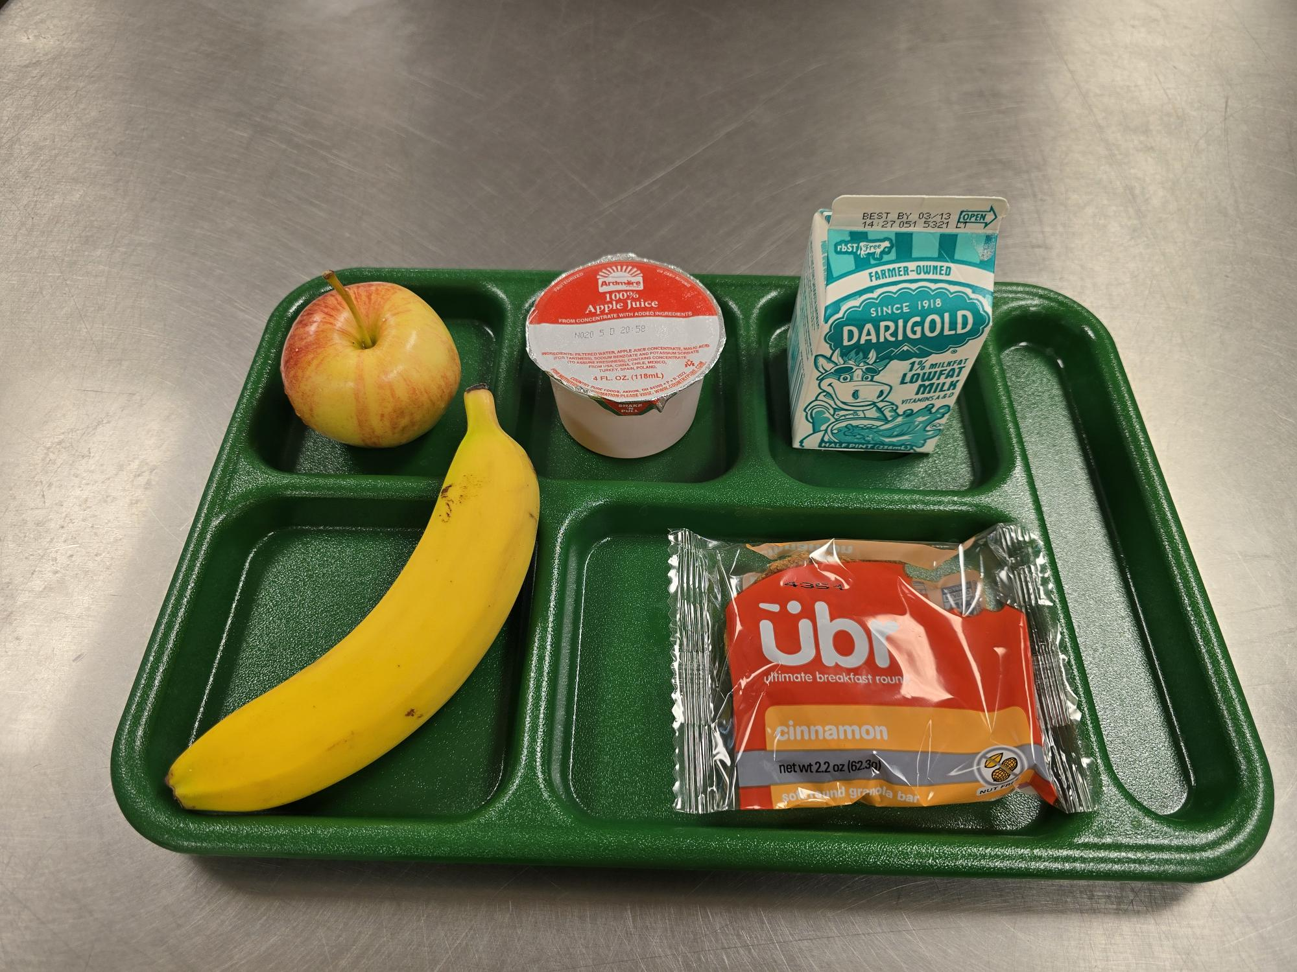
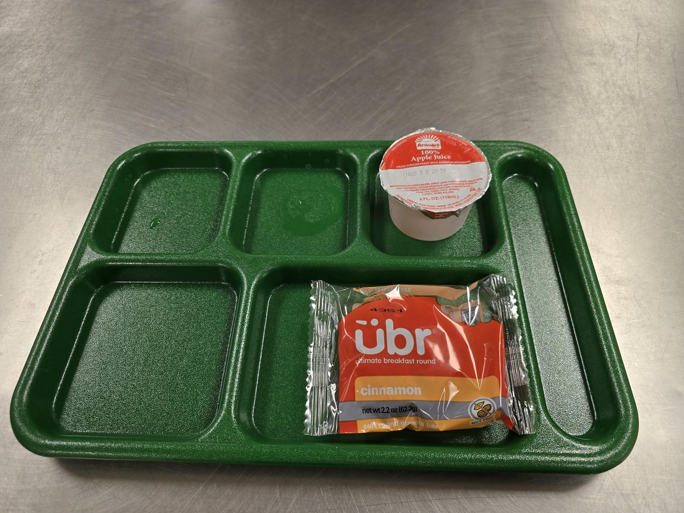
Meal Pattern Requirements - Components
Fruit (F)
Juice: Must be pasteurized, full-strength 100% fruit juice
Juice can meet no more than 50% of the offered fruit component per week
Dried fruit credits as twice the volume served
¼ cup of dried fruit = ½ cup of fruit
Based on minimum daily servings PLUS total servings over a 5-day school week
Available to Student
Student Choice

Slide 19
Meal Pattern Requirements - Components
Fruit (F)
 | Grade K-5 | Grade 6-8 | Grade 9-12
Breakfast | 5 cups/week (1 cup daily min) | 5 cups/week (1 cup daily min) | 5 cups/week (1 cup daily min)
Lunch | 2 ½ cups/week (1/2 cup daily min) | 2 ½ cups/week (1/2 cup daily min) | 5 cups/week (1 cup daily min)
Available to Student
Student Choice

Slide 20
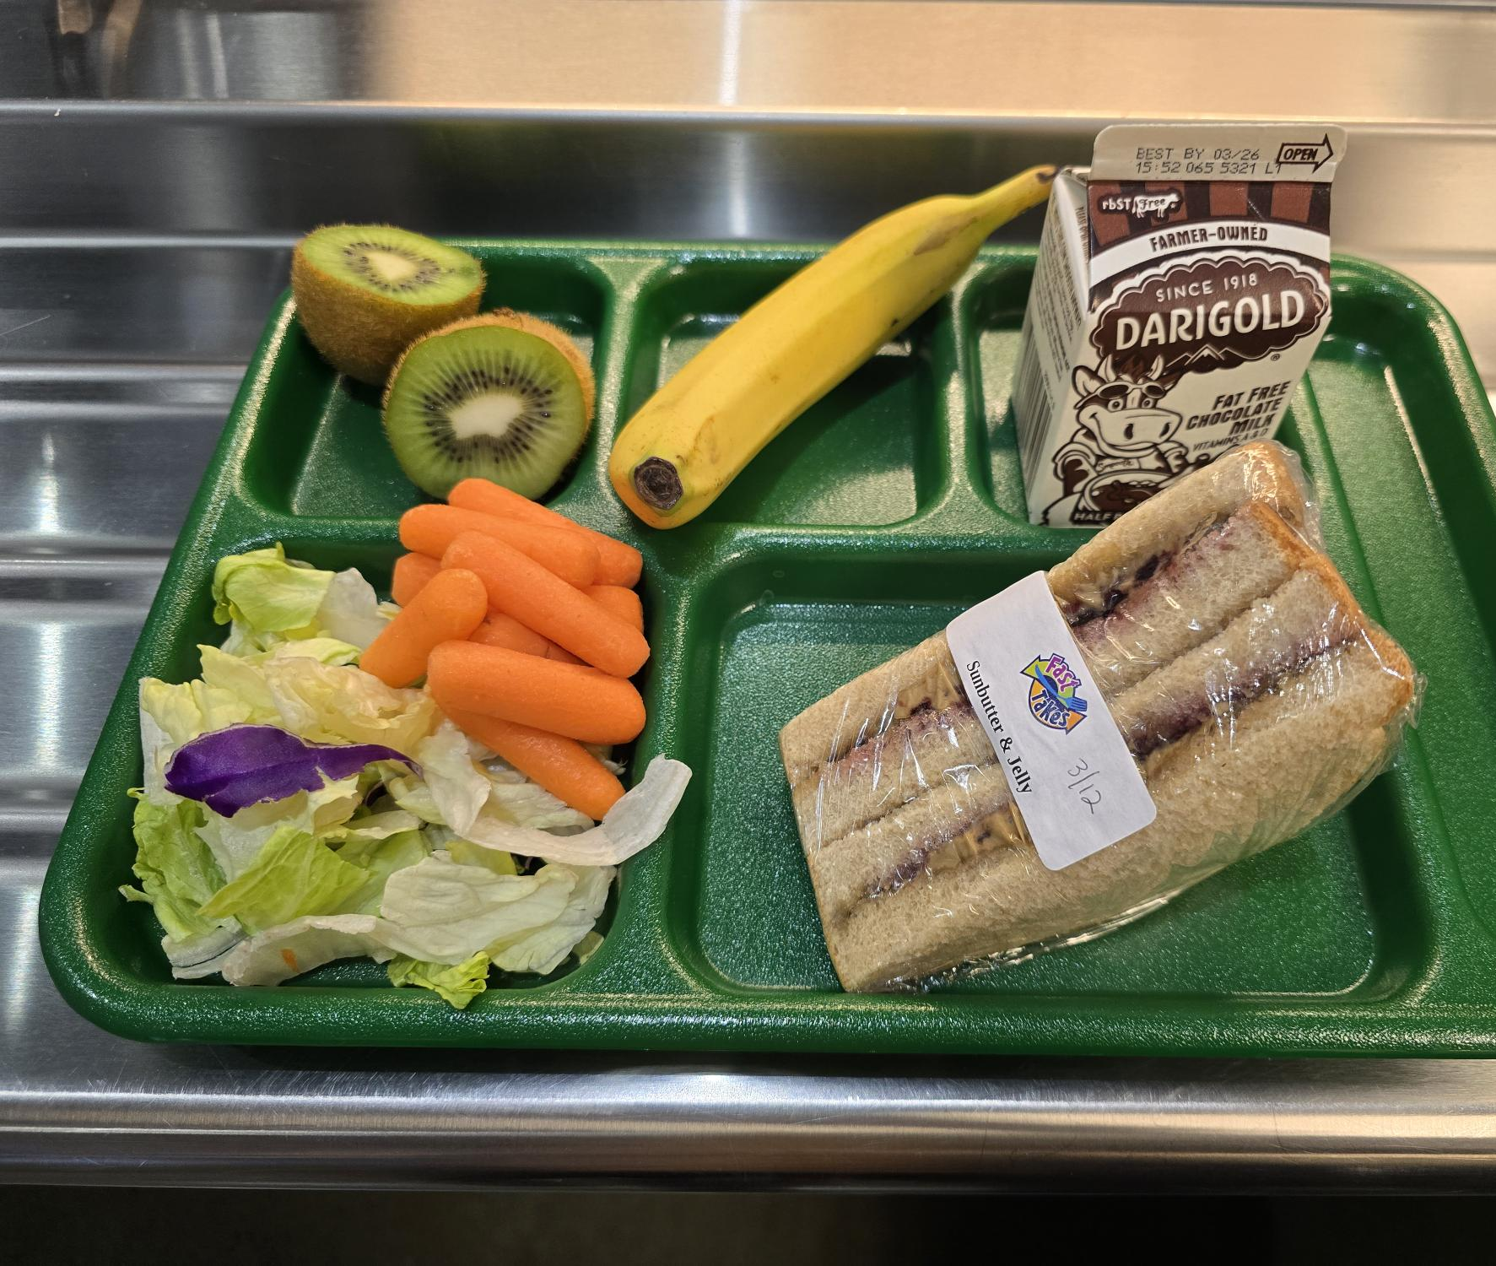
Meal Pattern Requirements - Components
Vegetables (V)
Only pasteurized, full-strength vegetable juice may be used to meet no more than 50% of the offered vegetable component
Cooked beans/peas (legumes) may be counted as either a vegetable OR a meat alternate, but not both in the same meal
Leafy greens credit as half the volume served
1 cup leafy greens = ½ cup vegetables
Vegetable offerings over the course of the week MUST include the 5 subgroups:
Dark Green: broccoli, spinach, romaine
Red-Orange: carrots, sweet potatoes, tomatoes
Beans, Peas, & Lentils (BPL): black beans, chickpeas, kidney beans
Starchy: corn, potatoes, green peas
Other: cucumber, cauliflower, green beans, mushrooms
Based on minimum daily servings PLUS total servings AND subgroup servings over a 5-day school week

Slide 21
Meal Pattern Requirements - Components
Vegetables (V)
 | Grade K-5 | Grade 6-8 | Grade 9-12
Breakfast | Not required. Schools are allowed to substitute vegetables for fruits. Schools choosing to offer vegetables ONE DAY PER WEEK can offer any vegetable. Schools choosing to substitute vegetables for fruits on TWO+ DAYS PER WEEK are required to offer vegetables from AT LEAST 2 DIFFERENT SUBGROUPS.
Lunch | 3 ¾ cups/week (3/4 cup daily min) | 3 ¾ cups/week (3/4 cup daily min) | 5 cups/week (1 cup daily min)
Dark Green Subgroup | ½ cup/week | ½ cup/week | ½ cup/week
Red/Orange Subgroup | ¾ cup/week | ¾ cup/week | 1 ¼ cup/week
BPL Subgroup | ½ cup/week | ½ cup/week | ½ cup/week
Starchy Subgroup | ½ cup/week | ½ cup/week | ½ cup/week
Other Subgroup | ½ cup/week | ½ cup/week | ¾ cup/week

Slide 22
Meal Pattern Requirements - Components
Milk (M)
Must be fat-free (flavored or unflavored) or low-fat (unflavored)
Can also use fat-free or low-fat lactose-free or reduced lactose milk
Two types must be offered at breakfast and lunch
Based on minimum daily servings
 | Grade K-5 | Grade 6-8 | Grade 9-12
Breakfast & Lunch | 5 cups/week (1 cup daily min) | 5 cups/week (1 cup daily min) | 5 cups/week (1 cup daily min)

Slide 23
Offer vs. Serve (OVS)
Allows students to decline some of the foods offered in a reimbursable lunch or breakfast
Meals are priced as a unit, even if a component(s) or item(s) is declined
Student must have the ability to choose the full amount of each component
Some foods are offered in large enough quantities by the menu planner to credit as two food items*
THINK: Large Apple = 1 cup or Large Muffin = 2 oz eq Grains
Breakfast:
Menu must offer at least 4 food items
Student must select at least 3 food items
For grains (or M/MA offered as grains) and milk, student must select the planned serving size
One of the items must be at least ½ cup fruit
Lunch:
Student must select 3 of the 5 components in the planned serving size
One of the items must be at least ½ cup serving of fruit and/or vegetable

Slide 24
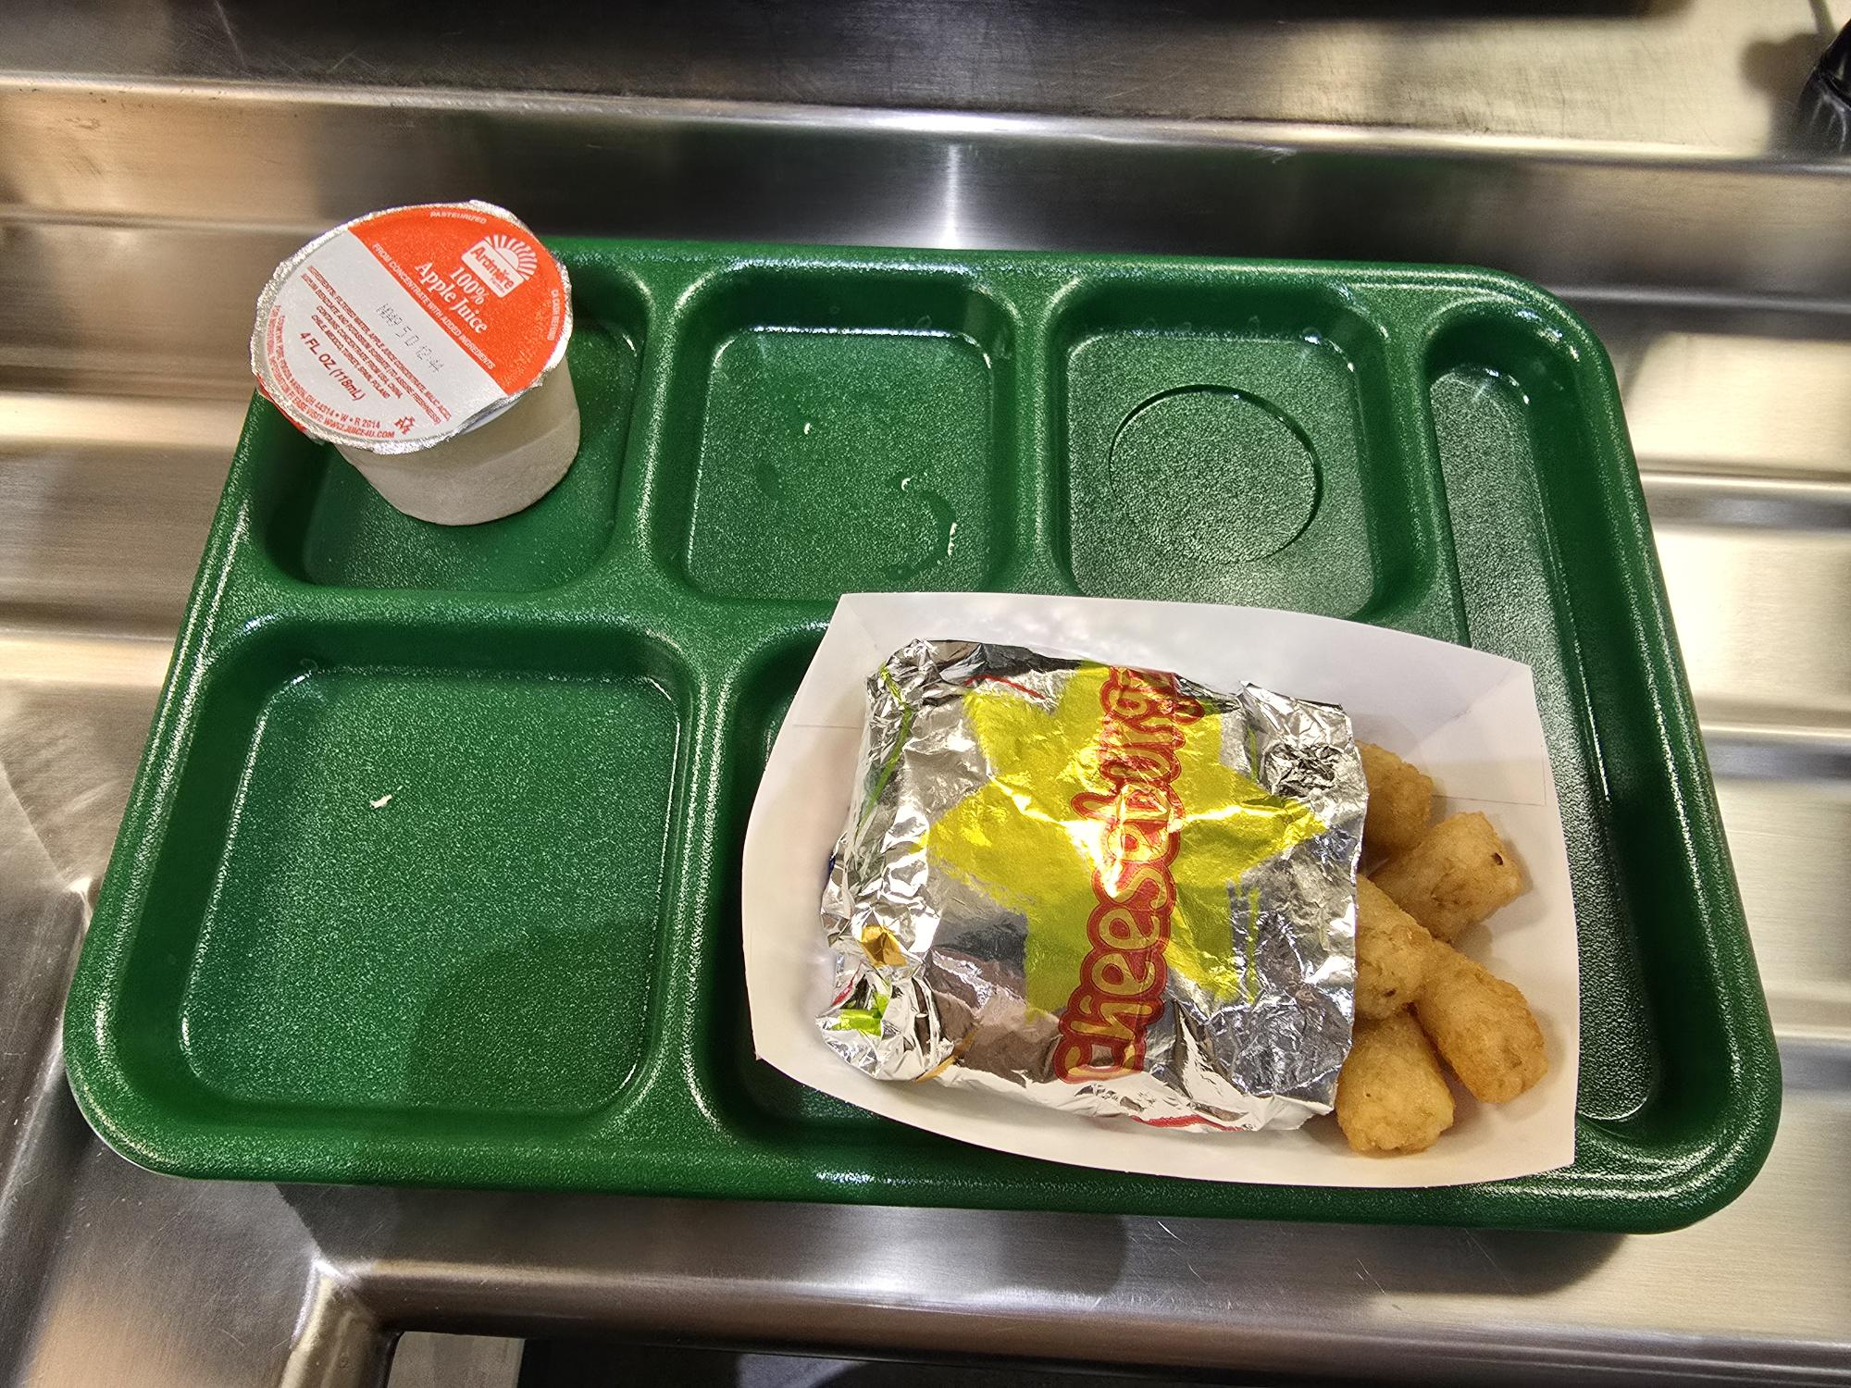
Offer vs. Serve (OVS)
Benefits:
Reduces food waste
Increases consumption and participation in school meals
Promotes student choice of foods they want to eat

Slide 25
Reimbursable Breakfast: UBR
MEAL:
8 oz Milk
1 medium Banana = ½ cup Fruit
1 Ultimate Breakfast Round = 2 oz eq Grains
1 163-ct. Apple = ½ cup Fruit
1 4 oz 100% Apple Juice = ½ cup Fruit
At Least 3 Food Items Selected
1 Item = ½ Cup Fruit
REIMBURSABLE

Slide 26
Reimbursable Breakfast: UBR
MEAL:
1 Ultimate Breakfast Round = 2 oz eq Grains
1 4 oz 100% Apple Juice = ½ cup Fruit
At Least 3 Food Items Selected
*Each oz eq of grain can count as 1 food item.
1 Item = ½ Cup Fruit
REIMBURSABLE
Notes:
Add slide about school meals being healthiest meals students eat USDA** closing
Questions
References slide
Contact information/cards

Slide 27
Reimbursable Lunch: Pizza
MEAL:
8 oz Milk
1 medium Kiwi = ½ cup Fruit
1 slice Cheese Pizza = 2 oz eq Grains, 2 oz eq M/MA
½ cup Salad = ¼ cup Vegetable
½ cup Baby Carrots = ½ cup Vegetable
1 4oz 100% Apple Juice = ½ cup Fruit
At Least 3 Food Components Selected
1 Item = ½ Cup Fruit and/or Vegetable
REIMBURSABLE

Slide 28
Reimbursable Lunch: Pizza
MEAL:
1 150-ct Tangerine = 1/2 cup Fruit
1 slice Pepperoni Pizza = 2 oz eq Grains, 2 oz eq M/MA
1 4 oz 100% Apple Juice = ½ cup Fruit
At Least 3 Food Components Selected
1 Item = ½ Cup Fruit and/or Vegetable
REIMBURSABLE

Slide 29
Reimbursable Lunch: Nachos
MEAL:
8 oz Milk
2 150-ct Tangerines = 1 cup Fruit
1 serving Chicken Nachos = 2 oz eq Grains, 2 oz eq M/MA
1 cup Salad = ½ cup Vegetable
½ cup Baby Carrots = ½ cup Vegetable
At Least 3 Food Components Selected
1 Item = ½ Cup Fruit and/or Vegetable
REIMBURSABLE

Slide 30
Reimbursable Lunch: Nachos
MEAL:
1 serving Chicken Nachos = 2 oz eq Grains, 2 oz eq M/MA
1 4 oz 100% Apple Juice = ½ cup Fruit
At Least 3 Food Components Selected
1 Item = ½ Cup Fruit and/or Vegetable
REIMBURSABLE

Slide 31
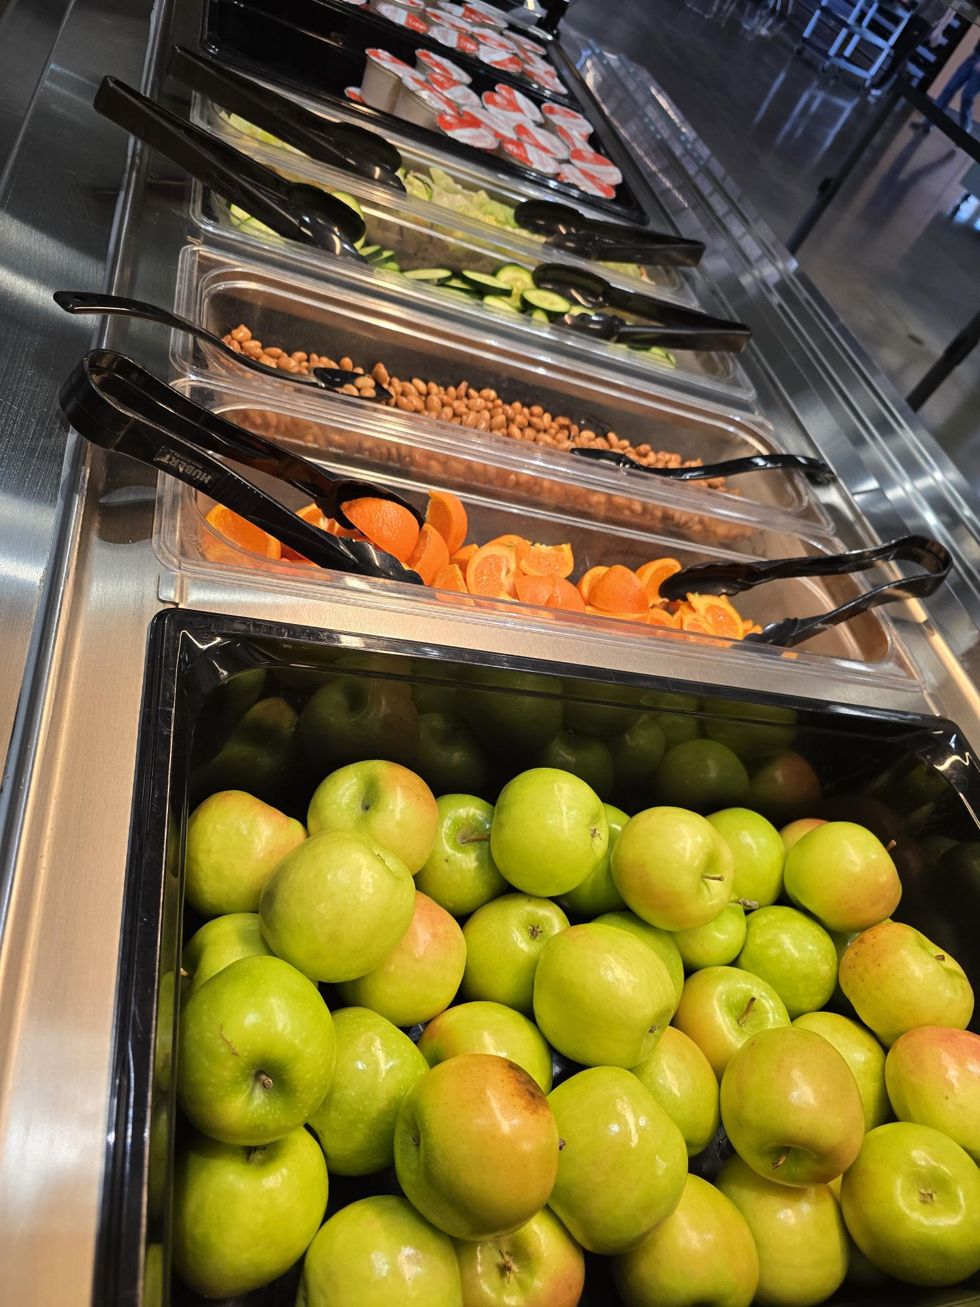
Additional Resources
Offering Bars
Utilize different, healthy choices that rotate through the meal pattern requirements for fruits and vegetables
Students can get servings from the offering bar at any time
Students who are still hungry are encouraged to get extra fruits and vegetables from the offering bar at no additional cost
A La Carte Purchases
Students are allowed to purchase additional items (such as entrees) a la carte

Slide 32
Why Does This Matter?
Research shows that lunches consumed from school are the most nutritious.
The Healthy Eating Index (HEI) assigns scores between 0-100 to meals based on how consistent they are with the Dietary Guidelines for Americans. Higher scores indicate higher nutritional quality.
When comparing school lunches with lunches from home (or other places):
 | School Lunch | Lunches from Home/Other
Average HEI Score (SY14-15) | 80/100 | 65/100
Milk | 66% | 23%
Fruits | 58% | 47%
Vegetables | 43% | 21%
Desserts/Snacks/Non-Milk Beverages | 48% | 75%

Slide 33
Thank You!
Please reach out if you have any questions.
Amber Easter, GM eastera@woodlandschools.org 360-841-2956
Ayshia Ranjitsingh, RDN, LD, CD Ayshia.Ranjitsingh@sodexo.com

